Slide 1
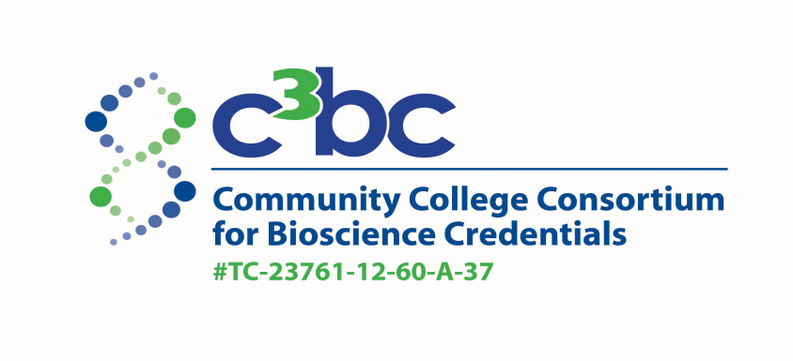

Community College Consortium for Bioscience Credentials
Medical Device Hub
​
​
​
​
​
Sengyong Lee PhD
Community College Day at BIO 2013
5-22-13 Chicago, IL

Slide 2
The Medical Device Industry:
“The industry covers a wide spectrum of products used in the treatment of patients, including cardiovascular devices, dental equipment, diagnostic devices, medical equipment and supplies, ophthalmic devices, orthopedic devices, respiratory devices and surgical equipment.”
-The United States Pharmacopeia and the National Formulary (USP–NF)
It is a highly diversified industry manufacturing a wide variety of health care products.
​
​
​
​
​

Slide 3
The US Medical Device Industry:
-Roughly $350-billion industry worldwide
-Thirty-two of the 46 medical technology companies with more than $1 billion in annual revenue are based in the US.
-Employs more than 400,000 Americans directly and 2 million people indirectly
-One of the few American manufacturing industries that consistently exports more than it imports.
- http://www.mddionline.com/article/medtech-2012-SWOT
​
​
​
​
​

Slide 4
Workforce Development Needs:
-Various career opportunities that require workers with a diverse education background
-Workers need to be able to navigate the challenging regulatory environment both domestically and in international markets
- In the BioCrossroads survey of Indiana medical device companies
​
​
​
​
​

Slide 5
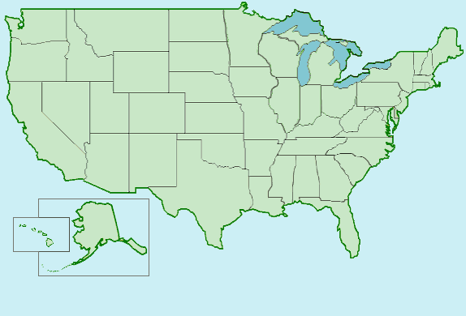
The Medical Device Hub Members:
College of the Canyons in CA
Ivy Tech Community College in IN
Moorpark College at Ventura County Community College District in CA
Mount Wachusett Community College in MA
Saint Petersburg College in FL
Salt Lake Community College in UT
Southern California Biomedical Council in CA
William Moor College of Technology in TN
​
​
​
​
​

Slide 6
The Main Goal for the MD Group:
-Identify core MD skills.
-Identify nationally harmonized skill sets for the MD jobs.
-Identify core Bioscience skills.
-Develop industry recognized credentials.
-Identify gaps in the current education program offerings.
-Redesign and implement courses.
-Develop a nationally harmonized MD curriculum.
-Develop a course and credit sharing mechanism among partner colleges.
-Recruit and educate TAA and other displaced workers
​
​
​
​
​

Slide 7
Working with the MD Industry:
Each partner college develops partnership with its regional MD companies.
Regional partnerships are connected at the national level.
Build a partnership with trade organizations like state BIO, MDMA and advaMed
Collaborate with other professional organizations like ASQ, RAPS, and others
​
​
​
​
​

Slide 8
MD Skill Set Standard Development:
Each partner college worked with their regional industry partners to collect the information on entry level jobs, tasks, and skills (survey, face to face meetings and DACUM).
The regional information was complied and validated though a national meeting
​
​
​
​
​

Slide 9
The 1st National MD Skill Set Harmonization Meeting:
Ivy Tech Bloomington on March 26 - 27 of 2013
Forty two representatives from MD companies, trade organizations, community colleges
Developed skill set matrices in 5 functional areas:
Regulatory affairs
Engineering (R&D)
Manufacturing
Quality
Facility & Instrumentation
​
​
​
​
​

Slide 10
Next Steps:
Complete the Skill Set Matrix by the end of May 2013
Gap analysis on our current program offerings
Development of harmonized curriculum through the second national conference in St. Petersburg in September of 2013
Development of MD & Bioscience Core credentials through the third conference in Salt Lake City, Utah 2014
​
​
​
​
​

